Slide 1
Agile Methodology

Slide 2
What is Agile ?
Agile is a software development methodology to build a software incrementally using short iterations of 1 to 4 weeks so that the development is aligned with the changing business needs.

Slide 3
How Agile is different ?
Instead of a single-pass development of 6 to 18 months where all the requirements and risks are predicted upfront, Agile adopts a process of frequent feedback where a workable product is delivered after 1 to 4 week iteration.

Slide 4
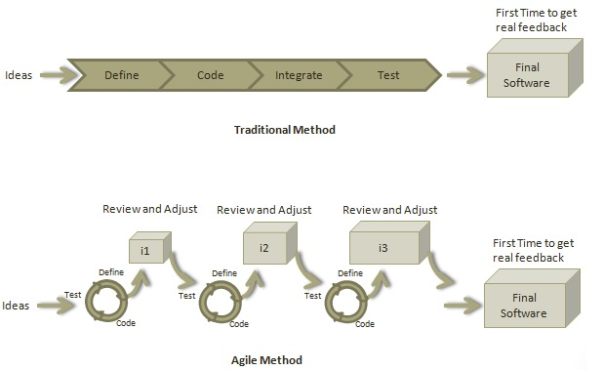

Slide 5
Twelve Principles of Agile Manifesto
Customer Satisfaction
Welcome Change
Deliver a Working Software
Collaboration
Motivation
Face-to-face Conversation
Measure the Progress as per the Working Software
Maintain Constant Pace
Monitoring
Simplicity
Self-organized Teams
Review the Work Regularly

Slide 6
Roles in Agile
Scrum Master
A Scrum Master is a team leader and facilitator who helps the team members to follow agile practices so that they can meet their commitments.

Slide 7
Responsibilities of Scrum Master
To enable close co-operation between all roles and functions.
To remove any blocks.
To shield the team from any disturbances.
To work with the organization to track the progress and processes of the company.
To ensure that Agile Inspect & Adapt processes are leveraged properly which includes
Daily stand-ups,
Planned meetings,
Demo,
Review,
Retrospective Meetings, and
To facilitate team meetings and decision-making process.

Slide 8
Example of Retrospective meeting
PREP
Book a meeting room for at least an hour: 15 minutes to set up, 30 minutes for the session, and 15 minutes to take photos and clean up.
Come 15 minutes ahead of the rest of the team, and bring all supplies listed above. Draw the headings "What did we do well?" and "What should have we done better?" up on the whiteboard.

Slide 9
STEP 1
Set the stage (5 min)
Welcome everyone to the retrospective meeting and establish the rules of engagement:
Embrace a positive spirit of continuous improvement and share whatever you think will help the team improve.
Don't make it personal, don't take it personally.
Listen with an open mind, and remember that everyone's experience is valid (even those you don't share).
Set the boundary of your discussion – is it that last sprint? the last quarter? since the project started? Be clear how far back you're going to go.
Encourage the team to embrace an improvement mindset, away from blame.

Slide 10
STEP 2
What went well? (10 min)
Start the session on a positive note. Have each team member use green sticky notes to write down what they feel went well (one idea per sticky). As people post their stickies on the whiteboard, the facilitator should group similar or duplicate ideas together.
Discuss your ideas briefly as a team.

Slide 11
STEP 3
What needs improvement? (10 min)
Same structure as above, but using pink or red stickies. Remind
your team that this is about actions and outcomes – not about
specific people.

Slide 12
STEP 4
Next steps (5 min)
Having identified what didn't go so well, what concrete actions can the team take to improve those things? Have your team use blue sticky notes to place ideas on the board. Group them and then discuss as a team, agree to which actions you will take, assign owners and a due date to get them DONE.
Thank everyone for their involvement and their honesty. Quickly run through the list of follow-up items, their owners and due dates.

Slide 13
DO’s in retrospective meetings
Celebrate successes and congratulate the team for a job well done. This will improve team morale and motivate them to deliver even better work.
Have a moderator who leads the session. This can be the scrum master or a neutral person (external or internal).
Have a clear goal for each meeting. This will help the team stay on topic instead of getting sidetracked.
Determine the key issues you want to address in the retrospective. Don't try to tackle every issue at once, but identify the most important issues you want to resolve in each session.
Focus on the team and their relationship, not on the product. Retrospectives are there to help the team find ways to work better together.
Establish an environment in which every team member feels at ease to share their opinions. Make sure that everyone on the team is involved in the discussion and does not have to be afraid of being jduged.
Identify the actionable items for the next sprint. The function of retrospectives is not just looking at the previous phase, but also talk about the next steps.

Slide 14
Don’ts
Don’t end a retrospective and never think about it again. It’s important to keep track of previous retrospectives and whether you were able to achieve the goals you have set.
Don’t let the meeting be too negative. Retrospectives are not there for the team members to complain, it’s about resolving issues and improving the teamwork.
Don’t go into the meeting unprepared. Agile is all about flexibility and being dynamic, but that doesn’t mean that you should be unprepared. It’s difficult to come up with spontaneous ideas, so encourage the team members to sort their thoughts before the retrospective.
Don’t just focus on improving at all costs and pressure the team to implement all ideas that come up during the session. It takes all the fun out of the exercise and can hamper the team’s creativity.
Don’t let outsiders attend the meeting. Remember that retrospectives should focus on building the team’s relationship. Having the product owner or another executive in the room will make it difficult for the team to truthfully talk about mistakes or concerns.

Slide 15
Roles in Agile
Product Owner
A Product Owner is the one who drives the product from business perspective.

Slide 16
Responsibilities of Product Owner
To define the requirements and prioritize their values.
To determine the release date and contents.
To take an active role in iteration planning and release planning meetings.
To ensure that team is working on the most valued requirement.
To represent the voice of the customer.
To accept the user stories that meet the definition of done and defined acceptance criteria.

Slide 17
Roles in Agile
Cross-functional Team
Every agile team should be a self-sufficient team with 5 to 9 team members and an average experience ranging from of 6 to 10 years. Typically, an agile team comprises of 3 to 4 developers, 1 tester, 1 technical lead, 1 product owner and 1 scrum master.

Slide 18
Product Owner and Scrum master are considered to be a part of Team Interface, whereas other members are part of Technical Interface.

Slide 19
How an Agile Team Plans its Work?
An Agile team works in iterations to deliver user stories where each iteration is of 10 to 15 days. Each user story is planned based on its backlog prioritization and size. The team uses its capacity − how many hours are available with team to work on tasks − to decide how much scope they have to plan.

Slide 20
Point
A Point defines how much a team can commit. A point usually refers to 8 hours. Each story is estimated in points.

Slide 21
Capacity
Capacity defines how much an individual can commit.
Capacity is estimated in hours.

Slide 22
What is a User Story?
A user story is a requirement which defines what is required by the user as functionality. A user story can be in two forms −
As a <User Role> I want <Functionality> so that <Business Value>
In order to <Business value> as a <User Role> I want <Functionality>

Slide 23
Relationship of User Stories and Tasks
User story talks about what is to be done. It defines what a user needs.
Task talks about how it is to be done. It defines how a functionality is to be implemented.
Stories are implemented by tasks. Each story is a collection of tasks.
User story is divided into tasks when it is planned in current iteration.
Tasks are estimated in hours, typically from 2 to 12 hours.
Stories are validated using acceptance tests.

Slide 24
When a Story is Done
All tasks (development, testing) are completed.
All acceptance tests are running and are passed.
No defect is open.
Product owner has accepted the story.
Deliverable to the end-user.

Slide 25
What is Acceptance Criteria?
Criteria defines the functionality, behavior, and performance required by a feature so that it can be accepted by the product owner. It defines what is to be done so that the developer knows when a user story is complete.

Slide 26
How the Requirements are Defined?
A User Story,
With Acceptance Criteria, and
Tasks to implement the story.

Slide 27
Agile - Characteristics
Iterative/incremental and Ready to Evolve
Face-to-face Communication
Feedback Loop

Slide 28
What is Daily Stand-up?
A daily stand-up is a daily status meeting among all team members and it is held roughly for 15 minutes.
Every member has to answer three important questions −
What I did yesterday?
What I'll do today?
Any impediment I am facing.../ I am blocked due to...

Slide 29
Why Stand-up is Important?
The benefits of having a daily stand-up in agile are as follows
The team can evaluate the progress on a daily basis and see if they can deliver as per the iteration plan.
Each team member informs all about his/ her commitments for the day.
It provides visibility to the team on any delay or obstacles.

Slide 30
Who Attends a Stand-up?
The scrum master, the product owner, and the delivery team should attend the stand-up on a daily basis.
Stakeholders and Customers are encouraged to attend the meeting and they can act as an observer, but they are not supposed to participate in stand-ups.
It is the scrum master's responsibility to take note of each team member's queries and the problems they are facing.

Slide 31
Geographically Dispersed Teams
Stand-ups can be done in multiple ways, in case the agile team members are operating from different time zones −
Select a member on a rotational basis, who can attend the stand-up meeting of teams located in different time zones.
Have a separate stand-up per team, update the status of the stand-up in a tool such as Rally, SharePoint, Wikis, etc.
Have a wide variety of communication tools ready like conference call, video conferencing, instant messengers, or any other third-party knowledge sharing tools.

Slide 32
Agile - Definition of Done
User Story
Iteration
Release

Slide 33
User Story
A user story is a requirement which is formulated in a few sentences in everyday language of an user and it should be completed within an iteration. A user story is done when
All the related code have been checked-in.
All the unit test cases have been passed.
All the acceptance test cases have been passed.
Help text is written.
Product Owner has accepted the story.

Slide 34
Iteration
An iteration is a time boxed collection of user stories / defects to be worked upon and accepted within the release of a product. Iterations are defined during iteration planning meeting and completed with an iteration demo and review meeting. An iteration is also termed as a sprint. An iteration is done when
Product backup is complete.
Performance has been tested.
User stories have been accepted or moved to the next iteration.
Defects have been fixed or postponed to the next iteration.

Slide 35
Release
A release is a major milestone that represents an internal or external delivery of working, tested version of the product/system. A release is done when
System is stress tested.
Performance is tuned.
Security validations are carried out.
Disaster recovery plan is tested.

Slide 36
Agile - Release Planning
The purpose of release planning is to create a plan to deliver an increment to the product. It is done after every 2 to 3 months.

Slide 37
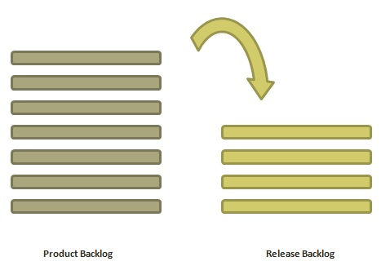

Slide 38
Who is Involved?
Scrum Master − The scrum master acts as a facilitator for the agile delivery team.
Product Owner − The product owner represents the general view of the product backlog.
Agile Team − Agile delivery team provides insights on the technical feasibilities or any dependencies.
Stakeholders − Stakeholders like customers, program managers, subject matter experts act as advisers as decisions are made around the release planning.

Slide 39
Prerequisites of Planning
A ranked product backlog, managed by the Product Owner. Generally five to ten features are taken which the product owner feels that can be included in a release
Team's input about capabilities, known velocity or about any technical challenge
High-level vision
Market and Business objective
Acknowledgement whether new product backlog items are needed

Slide 40
Materials Required
Posted agenda, purpose
Flip charts, whiteboards, markers
Projector, way to share computers having data/tools required during planning meeting
Planning data

Slide 41
Planning Data
Previous iterations or release planning results
Feedback from various stakeholders on product, market conditions, and deadlines
Action plans of previous releases / iterations
Features or defects to be considered
Velocity from previous releases/ estimates.
Organizational and personal calendars
Inputs from other teams and subject matter experts to manage any dependencies

Slide 42
Output
Release plan
Commitment
Issues, concerns, dependencies, and assumptions which are to be monitored
Suggestions to improve future release plannings

Slide 43
Agile - Iteration Planning
The purpose of iteration planning is for the team to complete the set of top-ranked product backlog items. This commitment is time boxed based on the length of iteration and team velocity.

Slide 44
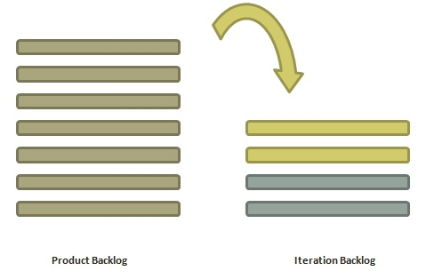

Slide 45
Who is Involved?
Scrum Master − The scrum master acts as a facilitator for the agile delivery team.
Product Owner − The product owner deals with the detailed view of the product backlog and their acceptance criteria.
Agile Team − Agile delivery defines their tasks and sets the effort estimates required to fulfil the commitment.

Slide 46
Prerequisites of Planning
Items in product backlog are sized and have a relative story point assigned.
Ranking has been given to portfolio items by the product owner.
Acceptance criteria has been clearly stated for each portfolio item.

Slide 47
Planning Process
Determine how many stories can fit in an iteration.
Break these stories into tasks and assign each task to their owners.
Each task is given estimates in hours.
These estimates help team members to check how many task hours each member have for the iteration.
Team members are assigned tasks considering their velocity or capacity so that they are not overburdened.

Slide 48
Velocity Calculation
An agile team calculates velocity based on past iterations. Velocity is an average number of units required to finish user stories in an iteration.

Slide 49
Task Capacity
Number of ideal working hours in a day
Available days of person in the iteration
Percentage of time a member is exclusively available for the team.

Slide 50
Planning Steps
Product Owner describes the highest ranked item of product backlog.
Team describes the tasks required to complete the item.
Team members own the tasks.
Team members estimate the time to finish each task.
These steps are repeated for all the items in the iteration.
If any individual is overloaded with tasks, then his/her task is distributed among other team members.

Slide 51
Agile - Product Backlog
A product backlog is a list of items to be done. Items are ranked with feature descriptions. In an ideal scenario, items should be broken down into user stories.

Slide 52
Why Product Backlog is Important?
It is prepared so that estimates can be given to each and every feature.
It helps in planning the roadmap for the product.
It helps in re-ranking the features so that more value can be added to the product.
It helps in determining what to prioritize first. Team ranks the item and then builds value.

Slide 53
Characteristics of Product Backlog
Each product should have one product backlog which can have a set of large to very large features.
Multiple teams can work on a single product backlog.
Ranking of features is done based on business value, technical value, risk management or strategic fitness.
Highest ranking items are decomposed into smaller stories during release planning so that they can be completed in future iterations.

